Slide 1
Project Title: Blinkit Sales Data Analysis
Name: Ishita Majumdar College: Narula Institute of Technology Department: Computer Science and Business Systems Semester: 6th Semester Internship Under: Classroom
📞 Contact Us 📱 Phone: 8981838547 🌐 Website: https://classroomtech.in 🔗 LinkedIn: https://www.linkedin.com/company/classroom-tech/ Duration: 3 months (1st April 2025 – 30th June 2025)

Slide 2
Acknowledgement
I would like to express my heartfelt gratitude to all those who supported me throughout the successful completion of this project.
First and foremost, I extend my sincere thanks to Mr. Satyaki Das for their invaluable guidance, timely feedback, and constant encouragement that helped shape this project from beginning to end.
I am also thankful to Classroom Tech for providing me with this internship opportunity for me to apply my analytical skills in a real-world scenario.
Lastly, I express my deepest gratitude to my family and well-wishers for their unwavering support, patience, and belief in me throughout this journey.
This project would not have been possible without the collective support of each of them.

Slide 3
Table of Contents
Page 1: Title Slide
Page 2: Acknowledgement
Page 3: Table of Contents
Page 4: Objective / Problem Statement
Page 5: Dataset Overview
Page 6: Datasets Used
Page 7: Tools Used
Page 8: Methodology
Page 9-42: Detailed Visualization Slides
Page 43: Key Findings
Page 44: Conclusion
Page 45: GitHub Repository Link
Page 46: References
Page 47: Thank You Note

Slide 4
Objective / Problem Statement
To analyze Blinkit's customer, order, delivery, inventory, and marketing data using Power BI to uncover insights and improve decision-making.

Slide 5
Dataset Overview
This project uses real-world e-commerce datasets simulating operations at Blinkit, sourced from Kaggle. The data was provided in 11 CSV files covering customers, orders, products, delivery performance, stock levels, and marketing campaign performance.

Slide 6
Datasets Used
Blinkit_Customers: containing customer details(ID, name, email, etc.)
Blinkit_Orders: contains order details and timestamps
Blinkit_Order_Items: has details of ordered items
Products: contains product details ( name, category, MRP, price, etc.)
Blinkit_Inventory and Blinkit_Inventory_New : contains stock details
Blinkit_Delivery_Performance: shows delivery statistics ( promised time,actual time, delivery status, distance in km,etc.)
Marketing Campaigns: shows statistics of different marketing campaigns (spend, clicks, conversions)
Blinkit_customer_Feedback: contained details of customer reviews
Emoji Ratings: represented emoji-based product satisfaction

Slide 7
TOOLS USED
Power BI for data modeling, DAX calculations, and dashboarding
GitHub for version control and project hosting

Slide 8
METHODOLOGY
Data Cleaning Steps:
Removed missing values from delivery time fields
Converted date/time columns to appropriate formats
Merged related tables (orders, customers, products)
Visualization Strategy:
Used column & bar charts for time-based trends
Pie and funnel charts for conversion and feedback analysis
Heatmaps and matrix views for geographical and categorical analysis
Line charts for time-series analysis

Slide 9
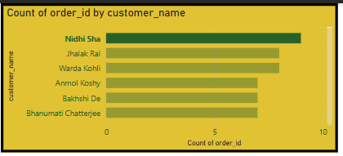
Used a Stack Bar chart to determine the top customers based on their orders
Nidhi Sha topped the list , having placed a total of 9 orders.

Slide 10
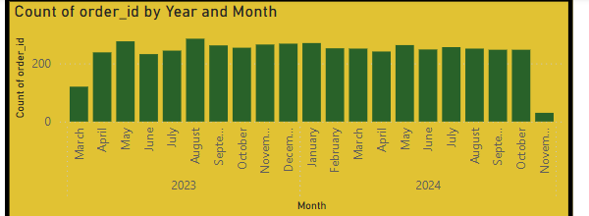
Used stacked column chart to see which month had the highest and lowest number of orders
August had the highest number of order. It had 285 orders.
November had the lowest number of orders – 30 orders

Slide 11
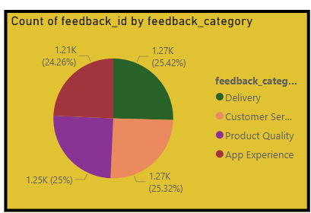
Created a pie chart to see the number of feedback in each criteria
Users had to say the most regarding deliveries.

Slide 12
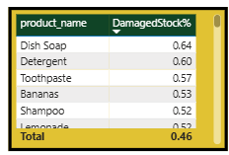
Created a table to sort Product names based on the percentage of damaged stock.
Dish Soap had the highest damaged stock with 64 percent
Cough Syrup had the lowest with 0.35 percent

Slide 13

Used a slicer to check delivery statuses
Mostly orders were delivered on time
However from the charts we could deduce that Noevember 2023 saw significant delay of deliveries

Slide 14
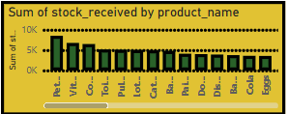
Created a stacked column chart to see which product had the maximum and minimum stock in inventory
Pet Products had the highest stock at 8,532 units, while Lemonade had the lowest at 498 units.

Slide 15
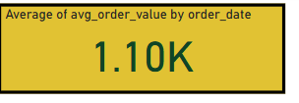
Used KPI Visualization
On an average 1.10K orders were placed per day

Slide 16

Used a KPI Visualization
The total revenue generated throughout 2023 and 2024 stood at INR 32.19 Million

Slide 17
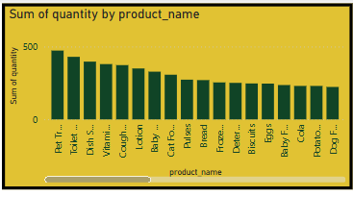
Created a clustered column chart categorizing product names by their quantities
Pet treats had the highest quantity (473)
Spinach had the lowest quantity (40)

Slide 18
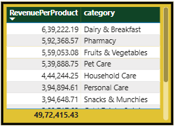
The table shows revenue generated by each category of product as well as the total reveneue..
Dairy and breakfast generated the highest revenue.
Instant Food and frozen food generated the lowest reveneue

Slide 19
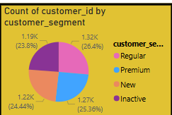
Created a pie chart to clearly distinguish customer segments.
Mostly there are regular customers followed by new and premium ones.
This indicates strong repeat business.

Slide 20
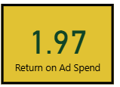
Created a Card Visual
It shows a return of 1.97 on advertisement spend.
Indicates that each INR 1 spent on ads generated INR 1.97 in revenue.

Slide 21
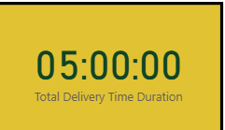
Created a card visual
It shows the sum of total delivery time required to deliver all ordered products throughout 2023 and 2024.

Slide 22
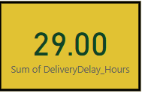
Created a card visual to check the overall delivery delay hours calculated using the columns promised time and actual time.
The cumulative delivery delay highlights gaps between promised and actual delivery times, which need optimization.

Slide 23
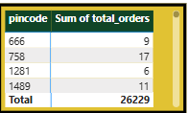
Used a table to check total number of orders against each pincode.

Slide 24
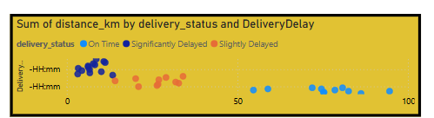
On-time deliveries occurred at both short and long distances.
Slightly delayed orders were mostly mid-range.
Significantly delayed deliveries even occurred at short distances — indicating internal or local operational issues.

Slide 25
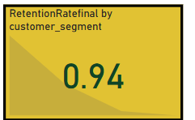
The customer retention rate is 0.94 .
Used a KPI visual to show it.
Shows excellent customer loyalty, with most customers placing more than one order.

Slide 26
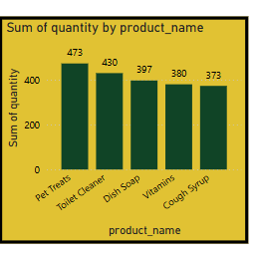
Created a clustered column chart.
Showed Top 5 products according to quantity.
Pet names topped the list.

Slide 27
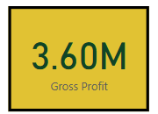
Used a card visual.
Depicts the gross profit throughout the year 2023 and 2024.

Slide 28
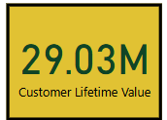
Customer Lifetime Value of ₹29.03 Million indicates strong revenue potential from repeated customers.
This also indicates consistent ordering behavior and moderate to high average order values across customer segments.

Slide 29

Pet Care products topped the sales charts in terms of volume, showing strong demand in that segment.

Slide 30
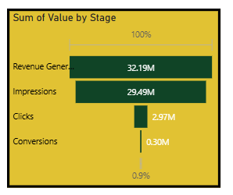
High impressions (29.49M) led to strong revenue generation (₹32.19M)
However ,only 10% of impressions resulted in clicks (2.97M).
Just ~1% of clicks converted into actual conversions (0.30M).

Slide 31
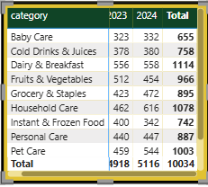
Table shows the number of orders placed for each category.
Comparatively more orders were placed in 2024 for every category.
Indicates improvement.
Household care products had the highest surge in orders.

Slide 32
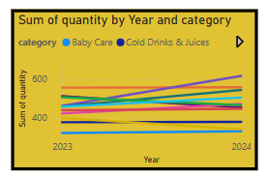
Household Care had the highest surge in orders from 2023 and 2024.
Frozen and Instant Foods saw a decline in orders.
Pharmacy also showed a decline in terms of orders

Slide 33
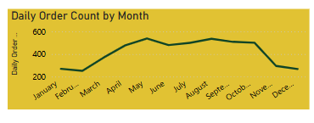
Steady growth in daily orders is seen from February to May, peaking around May–August.
A sharp decline is observed from October to December, with December having the lowest daily order count.

Slide 34
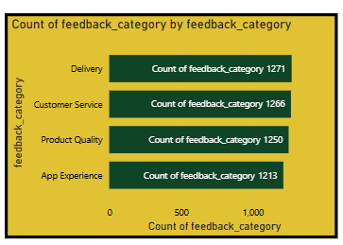
Most customer feedback was about Delivery, suggesting this area needs the most attention, followed by Product Quality and App Experience.

Slide 35
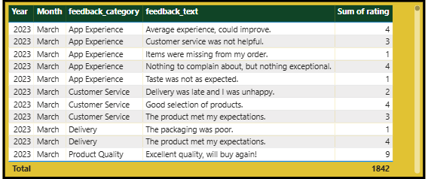
Performance was poor for the dairy category during specific time frames

Slide 36
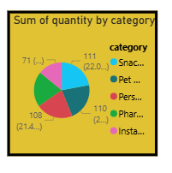
Delivery of Snacks and munchies was significantly delayed.
Happened probably due to high demand.

Slide 37
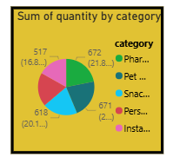
Pharma products were mostly on time
Indicates better priority handling and stable inventory.

Slide 38
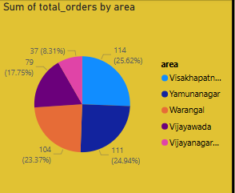
The pie chart shows the top 5 areas based on order quantity.
Vishakhapatnam topped the list with 25.62%.

Slide 39
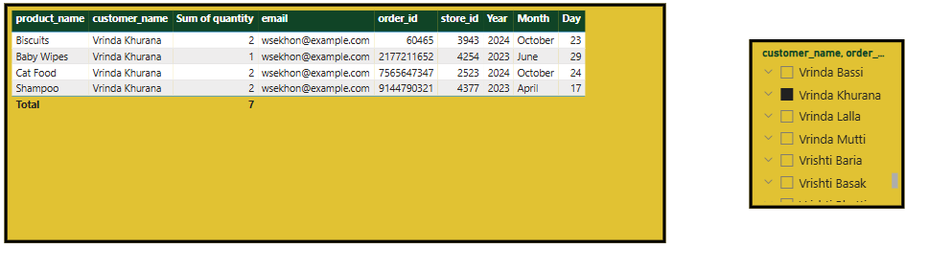
Added a slicer of names to check the order statistics of any customer.

Slide 40
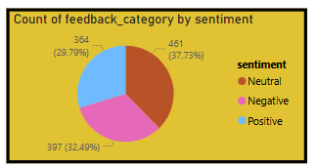
Created a pie chart to categorize number of feedback by their sentiments.
Mostly there were neutral feedbacks followed by negative and positive ones

Slide 41
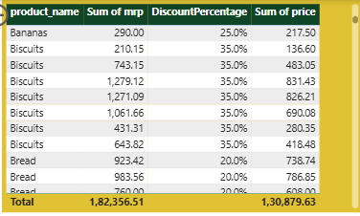
Created a table showing the mrp of each product , the discount applied as well as the final price.
The discount percentage varies, ranging from 25% to 35% , with variation across products.

Slide 42
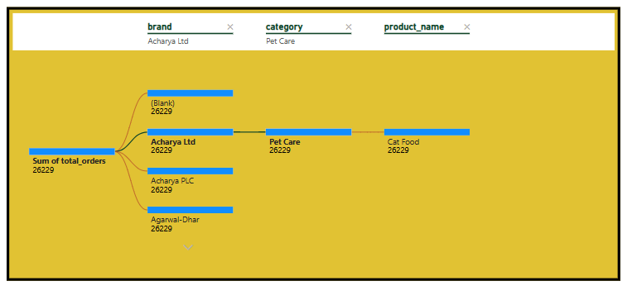
Created a decomposition tree
Archarya Ltd were the biggest suppliers for pet care (cat Food) and personal care(Lotion).
Agarwal-Dhar were the biggest suppliers for Fruits and vegetables (onions)

Slide 43
Key Findings
Strong Customer Retention
Customer retention rate is 0.94, showing that most customers placed repeat orders, indicating high satisfaction and trust in the platform.
Delivery Issues Identified
A noticeable spike in delivery delays during November 2023, including short-distance deliveries, points to internal logistic inefficiencies unrelated to route length.
Top Products and Categories Driving Sales
Pet Care products topped both in quantity sold and stock received.
Dairy and Breakfast generated the highest revenue across all categories.
Marketing Funnel Drop-Off
Out of 29.49M impressions, only 0.3M converted, revealing a major drop-off between clicks and conversions. This highlights a need for better targeting and landing page optimization.
Inventory and Damage Issues
Dish Soap had the highest damage rate (64%) despite high stock, while Cough Syrup had the lowest (0.35%) .

Slide 44
Conclusion
During this project, I learned how to analyze real-world business data using Power BI by integrating multiple datasets, creating meaningful visualizations, and applying advanced DAX calculations.
This analysis provides actionable insights that can help Blinkit:
Optimize marketing budgets by focusing on campaigns with higher ROAS
Improve delivery efficiency by analyzing delays across geography and product types
Manage inventory smarter by reducing damaged stock and forecasting demand
Enhance customer experience by addressing feedback and promoting high-CLV users

Slide 45
Github Repository Link
Blinkit Sales Data Analysis Repository - https://github.com/Ishita0807/Blinkit-Data-Analysis

Slide 46
References
Dataset Source: Blinkit Sales and Marketing Data – Kaggle (https://www.kaggle.com/datasets/akxiit/blinkit-sales-dataset)
Tools and Platforms Used: Power BI Desktop, GitHub, Microsoft Excel, Power Query, DAX
Internship Support: Classroom Tech – Internship platform and project guidance (https://classroomtech.in)
Additional Resources: Microsoft Learn (docs.microsoft.com) for DAX and Power BI documentation

Slide 47
THANK YOU

